Slide 1

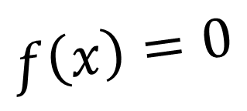
Bracketing Methods
$$f\left(x\right)=0$$
Class 15
September 14, 2022

Slide 2
Structure
Main Program
User input: xLow, xHigh, tolerance
Call method_3_Root()
Display root
User input: xLow, xHigh, tolerance
Call bisectionRoot()
Display root
mainBisection
mainMethod_2
mainMethod_3
User input: xLow, xHigh, tolerance
Call method_2_Root()
Display root
bisectionRoot
method_2_Root
method_3_Root
Check 1: Initial guess = root
Check 2: Root is bracketed
Method: Perform iterations
Return root
Check 1: Initial guess = root
Check 2: Root is bracketed
Method: Perform iterations
Return root
Check 1: Initial guess = root
Check 2: Root is bracketed
Method: Perform iterations
Return root

Slide 3
Structure
Main Program
User input: xLow, xHigh, tolerance
Call bisectionRoot()
Call method_1_Root()
Call method_2_Root()
Display roots
mainBracketingMethods
bisectionRoot
method_2_Root
method_3_Root
Check 1: Initial guess = root
Check 2: Root is bracketed
Method: Perform iterations
Return root
Check 1: Initial guess = root
Check 2: Root is bracketed
Method: Perform iterations
Return root
Check 1: Initial guess = root
Check 2: Root is bracketed
Method: Perform iterations
Return root

Slide 4
Structure
Main Program
User input: xLow, xHigh, tolerance
Check 1: Initial guess = root
Check 2: Root is bracketed
Call bisectionRoot()
Call method_1_Root()
Call method_2_Root()
Display roots
mainBracketingMethods
bisectionRoot
method_2_Root
method_3_Root
Check 1: Initial guess = root
Check 2: Root is bracketed
Method: Perform iterations
Return root
Check 1: Initial guess = root
Check 2: Root is bracketed
Method: Perform iterations
Return root
Check 1: Initial guess = root
Check 2: Root is bracketed
Method: Perform iterations
Return root

Slide 5
Structure
Main Program
User input: xLow, xHigh, tolerance
Check 1: Initial guess = root
Check 2: Root is bracketed
Call bisectionRoot()
Call method_1_Root()
Call method_2_Root()
Display roots
mainBracketingMethods
bisectionRoot
method_2_Root
method_3_Root
Method: Perform iterations
Return root
Method: Perform iterations
Return root
Method: Perform iterations
Return root

Slide 6
f(x) = 3x + sin(x) - e^{x}

Slide 7

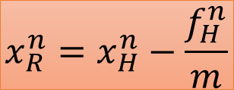

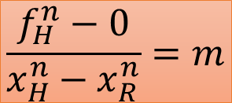
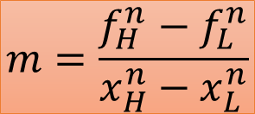
The False-Position Method: $\left[0.2, 1\right]$
$$m=\frac{f_{H}^{n}−f_{L}^{n}}{x_{H}^{n}−x_{L}^{n}}$$
$$\frac{f_{H}^{n}−0}{x_{H}^{n}−x_{R}^{n}}=m$$
L
R
H
$$x_{R}^{n}=x_{H}^{n}−\frac{f_{H}^{n}}{m}$$

Slide 8
The Modified False-Position Method: $\left[0, 1.5\right]$
$$x^{4}−1=0$$

Slide 9
The Modified False-Position Method: $\left[0, 1.5\right]$
$$x^{4}−1=0$$

